Slide 1
Status Report: Coordinated Gameplaying Robots
Project By:
Anuj Gautam (069/BEX/404)
Dilip Paneru (069/BEX/413)
Ramesh Neupane (069/BEX/433)
Yesh Kumar Adhikari (069/BEX/447)

Slide 2
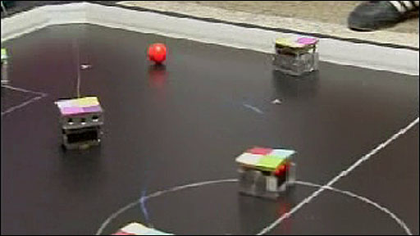
Project Overview
Multiple Robots working in a coordinated manner to play football.
Coordinated Gameplaying Robots

Slide 3
Progress Overview
Expected delivery
September 1, 2016
Recent progress
Ball position and velocity tracking
Hardware Implementation
Biggest problem
Real-time requirement of the project.

Slide 4
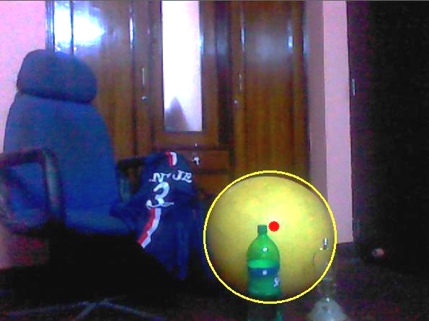
Progress - Software
Ball Position and Velocity Tracking (2D)
The calibrated ball in a controlled environment can be tracked
The program can further find out its velocity

Slide 5
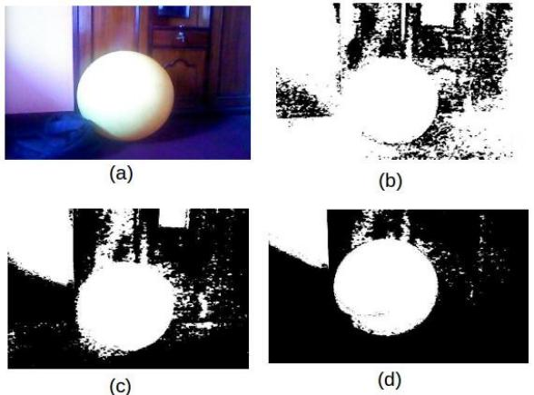
Ball Tracking
Feature extraction of the ball

Slide 6
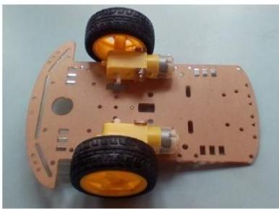
Progress - Hardware
Implementation of the Platform
The mobile platform needed for the project has been implemented
Platform currently works as an open-loop system

Slide 7
Attention areas
Communication System
RF communication seems unfeasible
Wi-Fi communication causes time-lag
Motor Precision
Slippage errors occur even when using rotary encoders
IMU introduces drift errors in the system
Camera has low resolution for error correction

Slide 8
Schedule

Slide 9
Study and Research
Hardware Prototype (30%)
Complete Product
Completed
15.05.2016
15.06.2016
01.07.2016
01.09.2016
Image Processing (70%)
Product Prototype

Slide 10
Gantt Chart

Slide 11
Next steps
Hardware Control System
An implementation of control algorithms(PID) and sensor fusion for feedback based precise hardware control.
Learning System
The learning module by which the robots learn utilizing a certain fitness function
Integration, Testing and Debugging
Integration of different parts of the project and their testing and debugging to bring forth a complete product.

Slide 12
Thank You!
Any Questions?

